Slide 1
Innovate and modernize apps with Data and AI

Slide 2

Abstract and learning objectives
Abstract and learning objectives
In this whiteboard design session, you will work with a group to design a solution for ingesting and preparing manufacturing device sensor data, as well as detecting anomalies in sensor data and creating, training, and deploying a machine learning model which can predict when device maintenance will become necessary.
Notes:
In this whiteboard design session, you will work with a group to design a solution for ingesting and preparing manufacturing device sensor data, as well as detecting anomalies in sensor data and creating, training, and deploying a machine learning model which can predict when device maintenance will become necessary.
At the end of this whiteboard design session, you will have learned how to capture Internet of Things (IoT) device data with Azure IoT Hub, process device data with Azure Stream Analytics, apply the Command and Query Responsibility Segregation (CQRS) pattern with Azure Functions, build a predictive maintenance model using Azure Synapse Analytics Spark notebooks, deploy the model to an Azure Machine Learning model registry, deploy the model to an Azure Container Instance, and generate predictions with Azure Functions accessing a Cosmos DB change feed. These skills will help you modernize applications and integrate Artificial Intelligence into the application.

Slide 3
Step 1: Review the customer case study
Outcome
Analyze your customer needs
Timeframe
15 minutes

Slide 4

Customer situation
Wide World Importers (WWI) is a global manufacturing company that handles distribution worldwide. They manufacture more than 9,000 different SKUs. They have data coming from CNC machines and sensors, as well as Manufacturing Execution Systems (MES).
WWI has five factories, each with about 10,000 sensors, for a total of approximately 50,000 sensors sending data in real-time.

Slide 5


Customer situation - 2
Today, their sensor data is collected into a Kafka cluster and processed via a custom consumer application that aggregates the events and writes the results to PostgreSQL. They have an event data store that currently runs in PostgreSQL. A web app connects to the data store and reports the status of the factory floor.

Slide 6

Customer situation - 3
WWI is running into scalability issues as they add manufacturing capacity, but in the course of addressing this concern, they would like to take the opportunity to modernize their infrastructure. In particular, they would like to modernize their solution to use microservices, and in particular, apply the Event Sourcing and Command and Query Responsibility Segregation (CQRS) patterns.

Slide 7

Customer situation - 4
They recognize their solutions will benefit from the cloud and want to ensure that they can manage their hybrid solution in a consistent way across both cloud and on-premises resources. The factories currently collect and analyze their operational data independently. They would like to deploy a cloud-based platform to centralize and allow storage of all data across all factories.

Slide 8
Customer needs
Centralize factory sensor data in the cloud using Platform-as-a-Service technologies whenever possible.
Replace local installations of Apache Kafka.
Have a solution which can keep up with a large number of sensors broadcasting data frequently.
Enable a hybrid on-prem/cloud solution with analytics data in the cloud but retaining on-prem capabilities in each factory.
Integrate machine learning, including anomaly detection and predictive maintenance.
Move toward a microservice approach for the website.
Notes:
1. We want to centralize our factory sensor data into the cloud, using PaaS services wherever possible.
2. We want to replace our local installations of Apache Kafka with a service that does not require on-premises administrators. Not all of our factories have dedicated Kafka administrators, which has led to avoidable data loss issues in the past.
3. The consumer group application we have built to process data from Kafka is our data pipeline bottleneck. When factory managers need to wait for information to come in, it typically is because the consumer group has fallen behind again. We want a system that can keep up with the torrent of device data our sensors generate.
4. Our factories are spread out across the world, and factory managers are used to near-real-time responses from the web applications hosted on on-premises servers. Instead of a pure cloud solution, we would like a hybrid cloud solution that allows our central office, located in Seattle, Washington, to oversee operations while still enabling factory managers to get the information they need at the speed to which they are accustomed.
5. In addition to storing data in the cloud, we would like to integrate machine learning into our application processing, including detecting anomalies in sensor data and predicting when machine maintenance will be necessary based on sensor data.
6. We want to reduce our reliance on a classic web application server for data processing and move toward a microservice approach.

Slide 9

Customer objections
WWI processes a large amount of sensor data at each factory and needs any cloud service to keep up.
Does Azure have capabilities to perform anomaly detection on sensor data? If so, how quickly could that be put into place?
Will a hybrid Azure and on-premises solution require additional administrators?
How quickly could WWI add new sensors to the provided solution? New manufacturing devices are added frequently and they need a solution which scales over time.

Slide 10
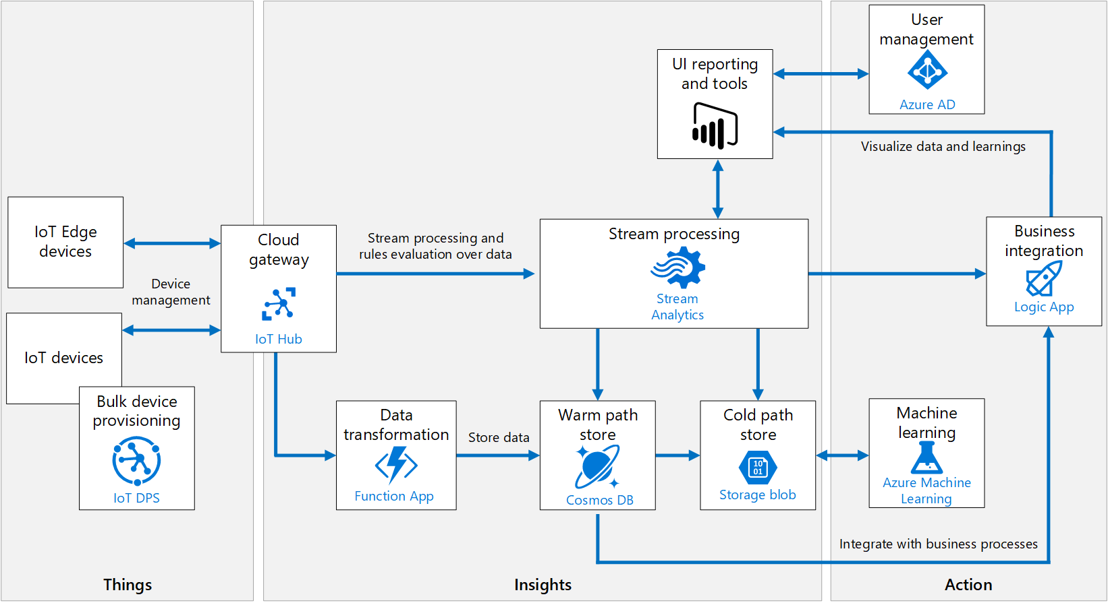
Common scenarios

Slide 11
Step 2: Design the solution
Outcome
Design a solution and prepare to present the solution to the target customer audience in a 15-minute chalk-talk format.
Timeframe
60 minutes
Business needs (10 minutes) | Respond to questions outlined in your guide and list the answers on a flipchart
Design (35 minutes) | Design a solution for as many of the stated requirements as time allows. Show the solution on a flipchart
Prepare (15 minutes) | Identify any customer needs that are not addressed with the proposed solution Identify the benefits of your solution Determine how you will respond to the customer’s objections Prepare for a 15-minute presentation to the customer

Slide 12
Step 3: Present the solution
Outcome
Present a solution to the target customer in a 15-minute chalk-talk format
Timeframe
30 minutes (15 minutes for each team to present and receive feedback)
Directions
Pair with another table
One table is the Microsoft team and the other table is the customer
The Microsoft team presents their proposed solution to the customer
The customer asks one of the objections from the list of objections in the case study
The Microsoft team responds to the objection
The customer team gives feedback to the Microsoft team

Slide 13
Wrap-up
Outcome
Identify the preferred solution for the case study
Identify solutions designed by other teams
Timeframe
15 minutes

Slide 14

Preferred target audience
Molly Fischer, Chief Information Officer (CIO), Wide World Importers
The primary audience is business and technology decision-makers. From the case study scenario, it would include the Director of Analytics.
Usually, we talk to the infrastructure managers who report to the chief information officer (CIO), or to application sponsors, such as a line of business (LOB) vice president (VP), chief marketing officer (CMO), or to those who represent the business unit IT or developers who report to application sponsors.

Slide 15
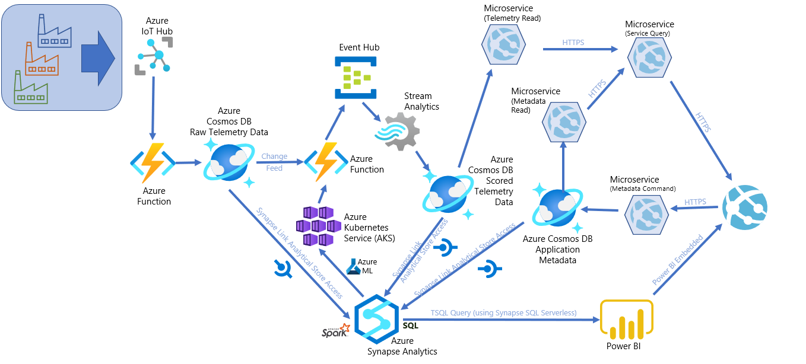
Preferred solution
Notes:
This diagram illustrates the high-level architecture for the solution.
The solution begins with multiple IoT devices, located within multiple factories, that securely connect to Azure IoT Hub to send telemetry. IoT Hub provides IoT device management, telemetry ingest at high volume, and the ability to send commands to devices as needed. IoT Edge allows individual manufacturing machines to interact with IoT Hub by sending telemetry messages to IoT Hub and by ensuring that edge devices are running the latest versions of deployed modules. Telemetry from IoT Hub automatically triggers an Azure function, which processes the events, assigns a unique `entity_id`, and stores them in an Azure Cosmos DB telemetry container. The document TTL (time-to-live) is set to 30 days, after which time they will automatically expire. The data is replicated long-term to the analytical store with no TTL. The analytical store saves all transactional data in columnar storage as Parquet files in Azure storage in a cost-effective way, automatically. No ETL required. A different Azure function implements event sourcing by triggering off the Azure Cosmos DB change feed for additional processing, including predictive maintenance scoring via a custom-trained Machine Learning model deployed to Azure Kubernetes Service (AKS) for real-time scoring. The function sends the scored data to an Azure Event Hub. Another function that consumes the change feed and saves the event data to domain entities, including state data, and stores them in Azure PostgreSQL Hyperscale (Citus). This database stores all sensor data as domain entities, partitioned by device Id, which the Hyperscale features uses to automatically shard the data for horizontal scaling and high performance reads and writes. An Azure Stream Analytics job reads the device telemetry, which includes the predictive maintenance prediction, and applies additional processing through a SQL-like query language. It uses an Azure Cognitive Services Anomaly Detector service to perform Changepoint and Spike-and-Dip anomaly detection. It also performs windowed aggregate queries against the time series data to create aggregates on machine maintenance predictions, grouped by maintenance requirement, factory, and machine. The temperature anomalies, telemetry with predictive maintenance scores, and temperature anomaly data is saved to another Azure Cosmos DB container, named `scored_telemetry`. Another Azure function implements event sourcing by triggering off the Azure Cosmos DB change feed from the `scored_telemetry` container. It saves the anomaly detection, windowed aggregates, and scored predictive maintenance event data to domain entities, including state data, and writes them to Azure PostgreSQL.
An Azure Synapse Analytics workspace securely connects to Azure Cosmos DB through a linked service, and uses the Synapse Link feature to access both the transactional store (OLTP) and analytical store (OLAP) of each Azure Cosmos DB container. The analytical store is optimized for read-heavy queries, which do not consume Azure Cosmos DB resource units (RUs), as opposed to reading the transactional store. All raw historical event data is accessible through the analytical store, which serves as the data lake, but with no ETL requirements. Synapse Spark notebooks read the analytical store to perform Machine Learning model training and deployments through Azure Machine Learning, data exploration, and batch scoring. Synapse pipelines are used for batch processing at scale over data fed into the analytical store from IoT devices originating from all factories. Wide World Importers data analysts use the Power BI integration capabilities of Synapse Analytics to create reports against Synapse Serverless views that display data from the analytical stores, as well as data stored in the SQL Pools. These reports are also embedded in the web application, making them available to end-users who do not have access to the Synapse Analytics workspace or Power BI online.
The web app is a modernized version of WWI's old monolithic web app, implementing a microservices pattern through Docker containers deployed to Azure. The CQRS pattern is applied by separating create, update, and delete (CUD) commands from query (read) commands, issued by microservices deployed to different containers. The metadata command microservice, for example, issues CUD commands to the `metadata` Azure Cosmos DB container. Factory, machine, maintenance criteria, and other metadata are stored in this container. A query microservice issues read requests to read microservices for telemetry data stored in Azure PostgreSQL, and metadata stored in Azure Cosmos DB.

Slide 16
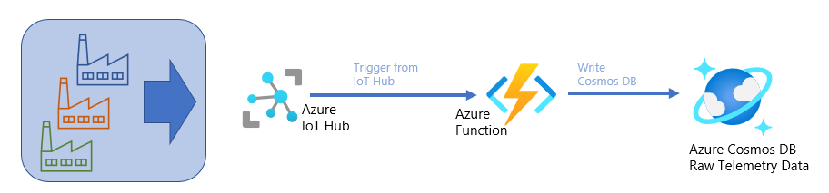
Preferred solution - 1
Azure IoT Hub provides device management and telemetry ingestion.
An Azure Function then processes events, assigns a unique entity ID, and stores results in a Cosmos DB telemetry container.
Notes:
The solution begins with multiple IoT devices, located within multiple factories, that securely connect to Azure IoT Hub to send telemetry. IoT Hub provides IoT device management, telemetry ingest at high volume, and the ability to send commands to devices as needed. IoT Edge allows individual manufacturing machines to interact with IoT Hub by sending telemetry messages to IoT Hub and by ensuring that edge devices are running the latest versions of deployed modules. Telemetry from IoT Hub automatically triggers an Azure function, which processes the events, assigns a unique `entity_id`, and stores them in an Azure Cosmos DB telemetry container. The document TTL (time-to-live) is set to 30 days, after which time they will automatically expire. The data is replicated long-term to the analytical store with no TTL. The analytical store saves all transactional data in columnar storage in a cost-effective way, automatically, with no ETL required.

Slide 17
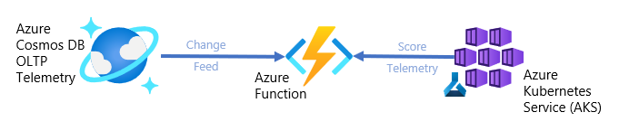
Preferred solution - 2
Another Azure Function reads the telemetry container’s change feed to perform data enrichment, including predictive maintenance scoring provided by a custom Azure Machine Learning model deployed on Azure Kubernetes Service. Results are stored in an Azure Event Hub, as well as Azure PostgreSQL Hyperscale.
Notes:
A different Azure function implements event sourcing by triggering off the Azure Cosmos DB change feed for additional processing, including predictive maintenance scoring via a custom-trained Machine Learning model deployed to Azure Kubernetes Service (AKS) for real-time scoring.

Slide 18
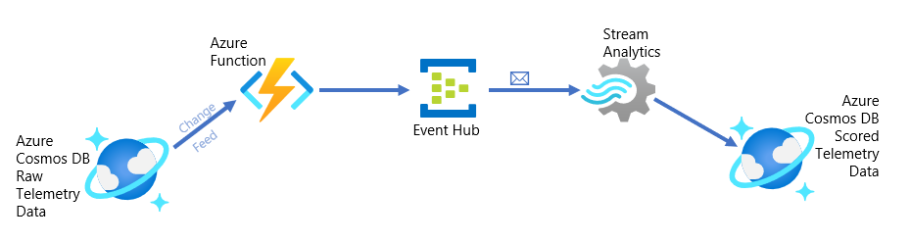
Preferred solution - 3
Azure Stream Analytics reads from Event Hub and uses Azure Cognitive Services to perform anomaly detection on the stream of data, storing results in a scored telemetry Cosmos DB container.
An Azure Function then processes the scored telemetry change feed and stores results in Azure Cosmos DB.
Notes:
The function sends the scored data to an Azure Event Hub. Another function that consumes the change feed and saves the event data to domain entities, including state data. This database stores all sensor data as domain entities, partitioned by device Id, which the Hyperscale features uses to automatically shard the data for horizontal scaling and high performance reads and writes. An Azure Stream Analytics job reads the device telemetry, which includes the predictive maintenance prediction, and applies additional processing through a SQL-like query language. It uses an Azure Cognitive Services Anomaly Detector service to perform Changepoint and Spike-and-Dip anomaly detection. It also performs windowed aggregate queries against the time series data to create aggregates on machine maintenance predictions, grouped by maintenance requirement, factory, and machine. The temperature anomalies, telemetry with predictive maintenance scores, and temperature anomaly data is saved to another Azure Cosmos DB container, named `scored_telemetry`. Another Azure function implements event sourcing by triggering off the Azure Cosmos DB change feed from the `scored_telemetry` container. It saves the anomaly detection, windowed aggregates, and scored predictive maintenance event data to domain entities, including state data, and writes them to Cosmos DB.

Slide 19
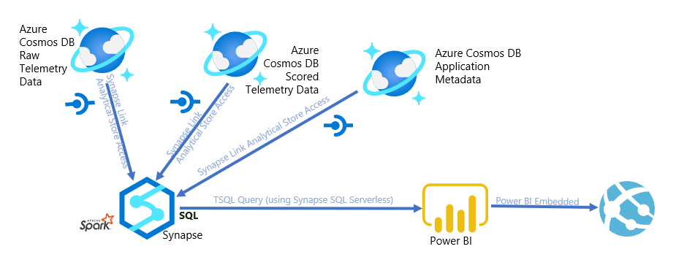
Preferred solution - 4
Azure Synapse Analytics notebooks read from the scored telemetry analytical store to populate a SQL Pool, which then populates a Power BI dashboard.
Notes:
An Azure Synapse Analytics workspace securely connects to Azure Cosmos DB through a linked service, and uses the Synapse Link feature to access both the transactional store (OLTP) and analytical store (OLAP) of each Azure Cosmos DB container. The analytical store is optimized for read-heavy queries, which do not consume Azure Cosmos DB resource units (RUs), as opposed to reading the transactional store. All raw historical event data is accessible through the analytical store, which serves as the data lake, but with no ETL requirements. Synapse Spark notebooks read the analytical store to perform Machine Learning model training and deployments through Azure Machine Learning, data exploration, and batch scoring. Synapse pipelines are used for batch processing at scale over data fed into the analytical store from IoT devices originating from all factories. Wide World Importers data analysts use the Power BI integration capabilities of Synapse Analytics to create reports against Synapse Serverless views that display data from the analytical stores, as well as data stored in the SQL Pools. These reports are also embedded in the web application, making them available to end-users who do not have access to the Synapse Analytics workspace or Power BI online.

Slide 20
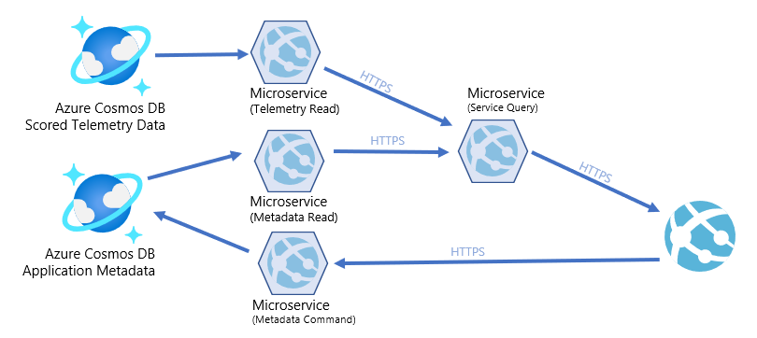
Preferred solution - 5
A web application implements a microservices pattern through Docker containers deployed to Azure.
Notes:
The web app is a modernized version of WWI's old monolithic web app, implementing a microservices pattern through Docker containers deployed to Azure. The CQRS pattern is applied by separating create, update, and delete (CUD) commands from query (read) commands, issued by microservices deployed to different containers. The metadata command microservice, for example, issues CUD commands to the `metadata` Azure Cosmos DB container. Factory, machine, maintenance criteria, and other metadata are stored in this container. A query microservice issues read requests to read microservices for telemetry and metadata from Azure Cosmos DB.

Slide 21
Preferred objections handling
WWI processes a large amount of sensor data at each factory and needs any cloud service to keep up. Azure IoT Hub can scale to 6,000 device-to-cloud send operations per unit per second, with a total of 50 IoT hubs per Azure subscription. Each IoT Hub unit can support 300,000,000 messages per day, so if we assume a device sends an update every five seconds, we can support over 17,000 devices on a single IoT Hub, or just over 868,000 in a subscription.

Slide 22
Preferred objections handling - 2
Does Azure have capabilities to perform anomaly detection on sensor data? If so, how quickly could that be put into place? Within Cognitive Services, there is an Anomaly Detector service available. This service allows customers to query a REST API or integrate directly with a client library to perform anomaly detection on time series data. Furthermore, this anomaly detection engine is built into Azure Stream Analytics, allowing you to perform Changepoint and Spike-and-Dip anomaly detection with streamed data.

Slide 23
Preferred objections handling - 3
Will a hybrid Azure and on-premises solution require additional administrators? With the proposed solution, this new architecture will not require additional administrators. Replacing Apache Kafka with IoT Hub would take Wide World Importers from a self-hosted system with significant maintenance requirements to a Platform-as-a-Service solution with little maintenance. Relying heavily on Platform-as-a-Service technologies like Azure Database for PostgreSQL, Cosmos DB, and Azure Machine Learning enable developer solutions without burdening administrators.

Slide 24
Preferred objections handling - 4
How quickly could WWI add new sensors to the provided solution? New manufacturing devices are added frequently and they need a solution which scales over time. With the proposed solution, adding a new device or a new sensor means configuring the sensor to use Azure IoT Edge to communicate with the existing IoT Hub. All of the other pieces continue to work as expected with no additional development effort, and all of the Platform-as-a-Service solutions allow for scaling out over time as Wide World Importers further automates its business.

Slide 25
Customer quote
"We thought we were at the forefront of technological innovation, but this engagement taught us just how much room we have to grow.“
Molly Fischer, CIO, World Wide Importers.

